Slide 1
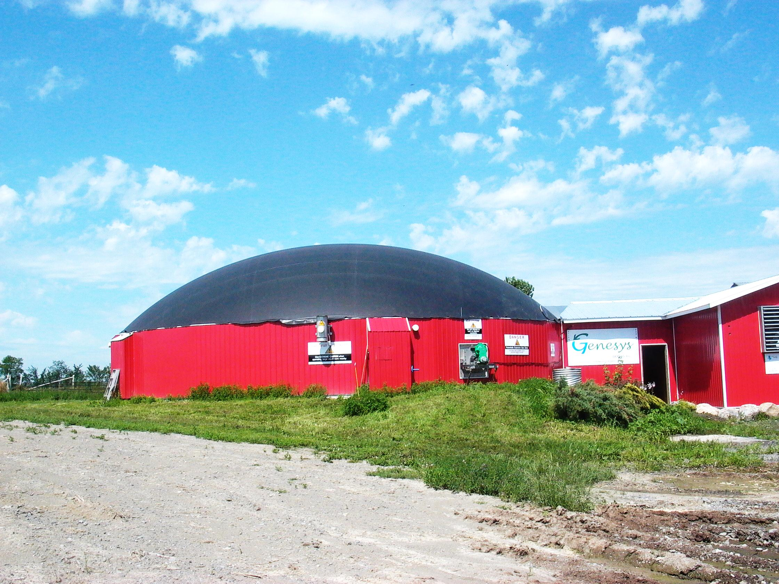
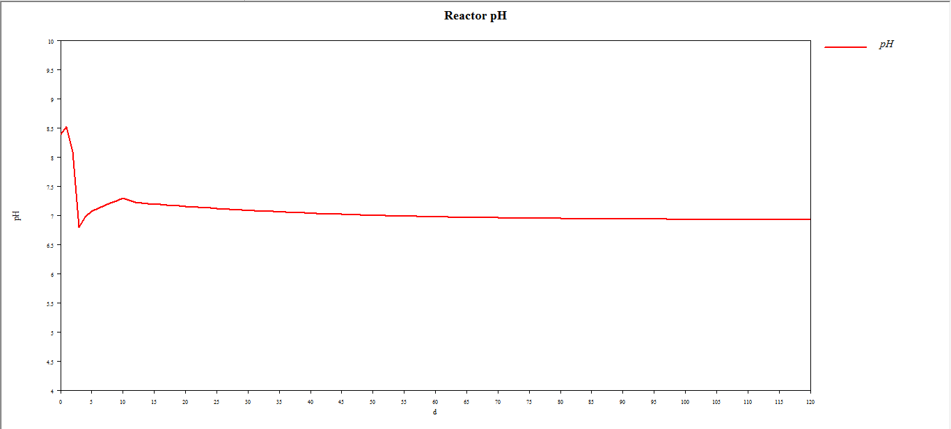
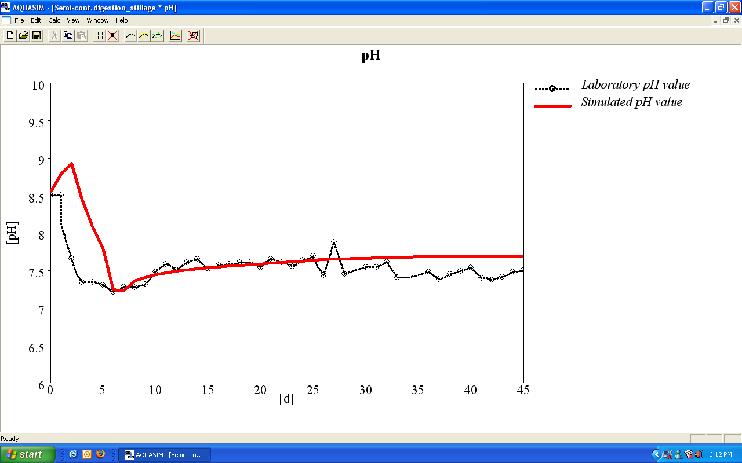
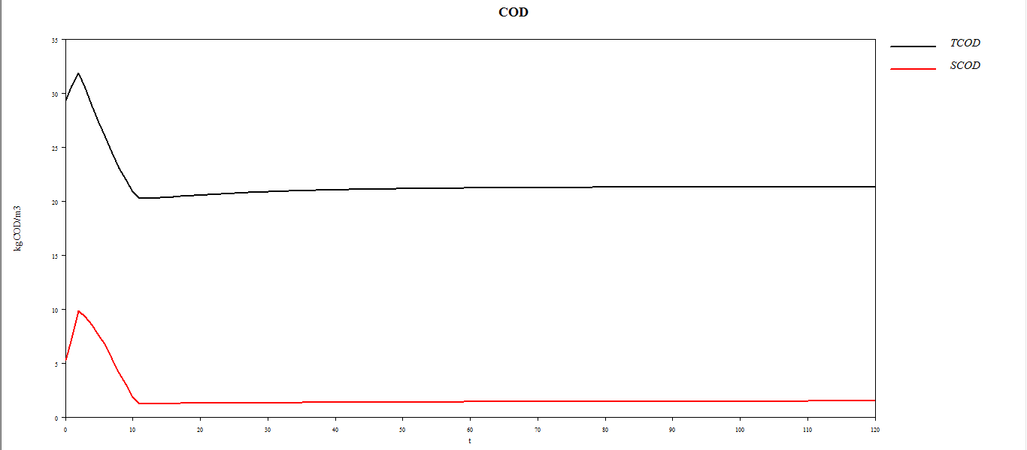
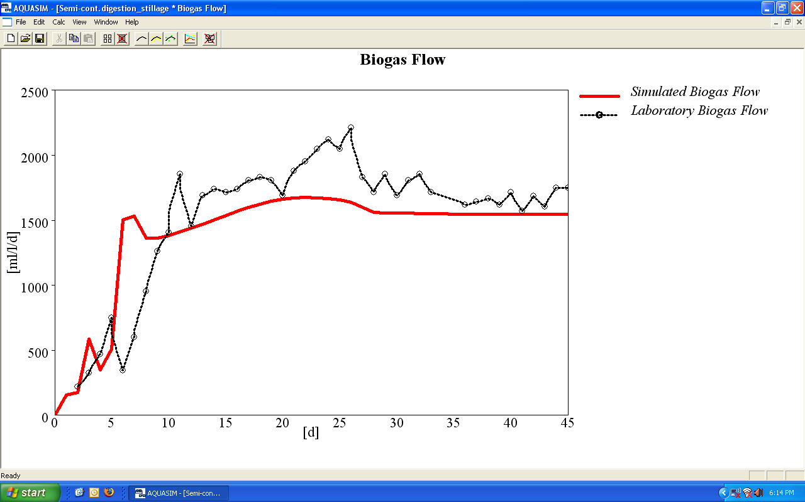
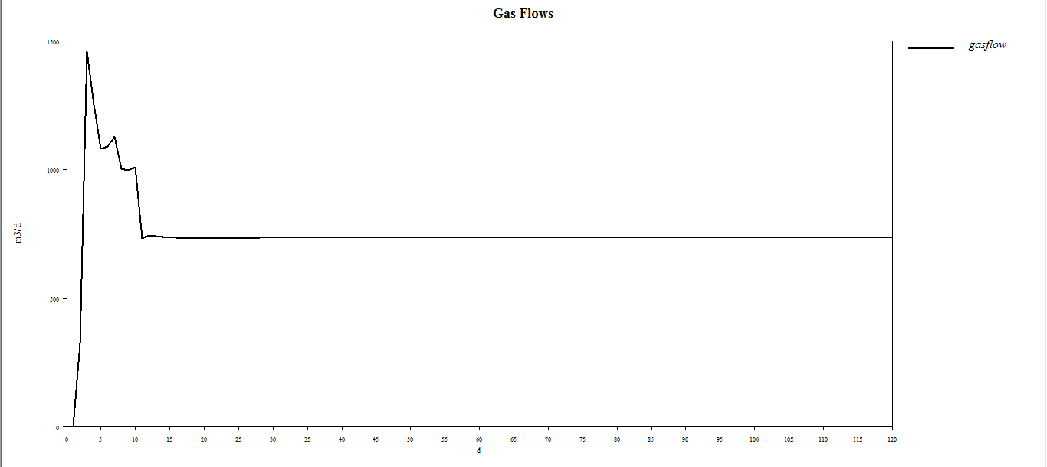
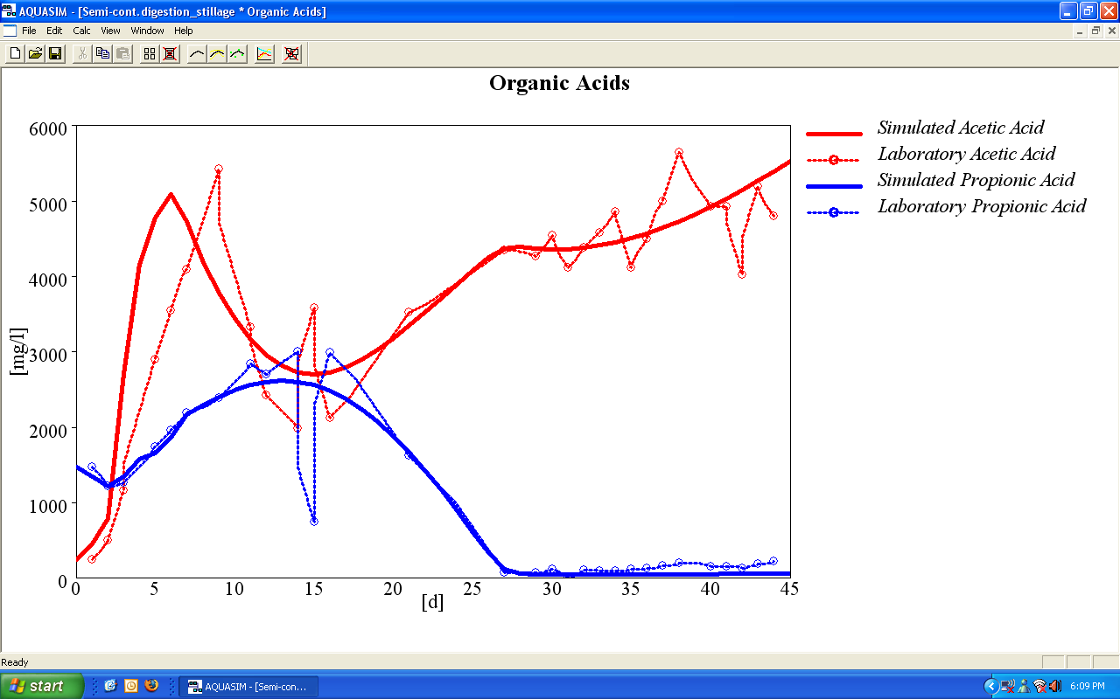
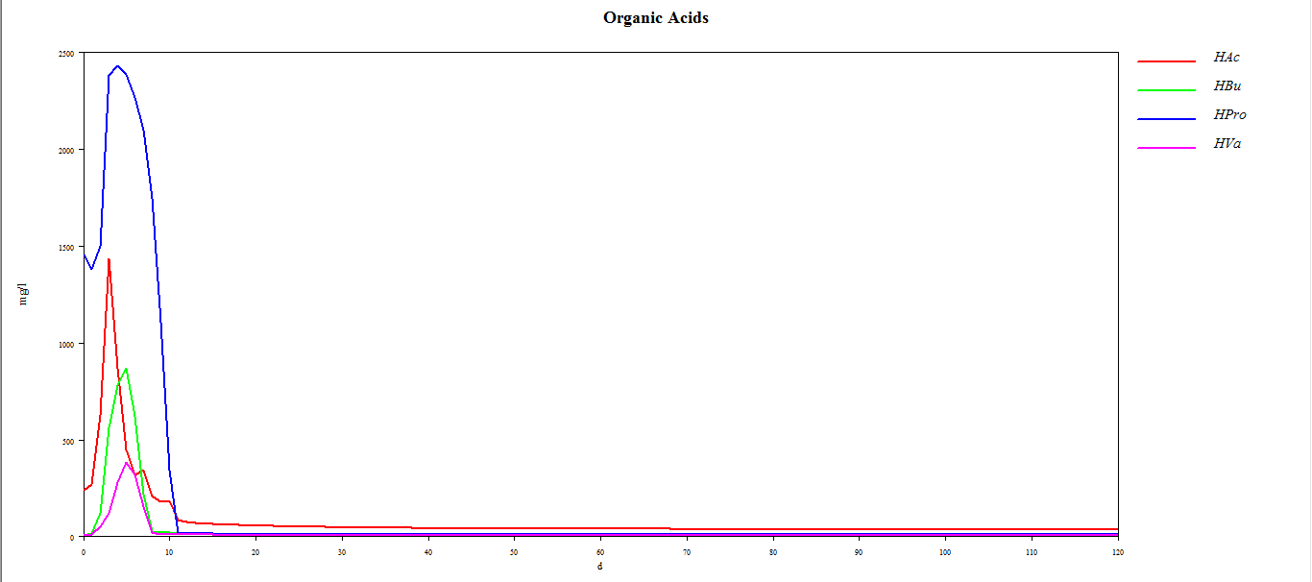
Simulating Anaerobic Digestion To Determine Feedstock Suitability
SIMULATING THE SUITABILITY OF CHEESE WHEY AS A FEEDSTOCK
AQUASim can be used to help determine the stability of an anaerobic digester and theoretical energy yields. Below are the AQUASim results from an anaerobic digester with cheese whey and manure as substrates. This digester configuration yields 90 kW of continuous electricity.
Benjamin Strehler; Claire Allen; Danmei Yang
WHY USE SIMULATION?
Anaerobic digestion is a highly complex process containing numerous biological and chemical reactions taking place simultaneously. The stability of an anaerobic digestion system depends on the composition of the substrates and how microorganisms themselves convert the given substrates.
To achieve adequate energy production, co-digestion using high strength feedstocks allows recycling of organics back into agricultural primary production while maximizing energy yields. These feedstocks push systems to their limit, requiring time-consuming lab-scale tests to predict system stability and biogas yields.
The program “AQUASim” was designed for the identification and simulation of anaerobic digestion in the laboratory, commercial systems and nature. CHFour Biogas Inc. adjusted the model to specific conditions within our anaerobic digestion systems. Various high strength substrates have been tested in lab-scale digesters and have been replicated by our computer simulation. Biogas composition and yields, pH, acids, and ammonia inhibitions predicted by AQUASim closely match lab results. This allows cost effective investigation of loading rates that ensure stable anaerobic digestion processes.
AVAILABLE SIMULATION SERVICES
Feedstock Analysis
System Stability and Indicator Analysis
Process Control Optimization
Operational Recommendations
Feeding Schedule Adjustments
ACCURACY OF MODEL
Our model accurately predicts pH, biogas production and composition, Chemical Oxygen Demand, and acid concentration.
The graphs below show how accurately our model correlates to laboratory data. The example shown below shows laboratory and model predictions of pH, gas flow and acid build up for the anaerobic digestion of a bioethanol by-product in a 4L continuous flow reactor.
Feedstock
Carbohydrates
Lipids
Hydrolysis
Acetogenesis
Acetic Acid
Hydrogen
Protein
Methanogenesis
Methane
Carbon Dioxide
Amino Acids
Fatty Acids
Monosaccharide
The manure and cheese whey anaerobic digester pH is approximately pH 7
Simulated pH values compared to measured pH values in the lab
COD and SCOD reduction is consistent
Simulated biogas flow compared to measured biogas flow in the lab
90 kW continuous electricity from cheese whey and manure
No build-up of organic acids
Simulated acid concentrations compared to measured acid concentrations in the lab

